Slide 1
Target User PPT
Ryuto Hashiya
S1 08

Slide 2
INSIGHT
I have a hard time standing my iPad up whenever I want to use my hands to do something else.

Slide 4
Problem Statement
The iPad stand has to have an extension so it can be placed depending on the surface.

Slide 5
PERSONALITY
BIO
Loud
Indoor person
Gamer
Laughs a lot
Ryu is someone that you can find in his or other’s rooms. He games because it is fun. Because he games a lot, he is a indoor person, thus he is good at most games. He is a loud person mostly due to how loud his voice is.
Found no good photos
Motivations
studying
games
sports
music
Ryu Bridgecliff
Goals
Frustrations
Age 15
Get better at music
To finish HW during class so I don’t have to do it later
To play games
Want to be lazy but can’t
Can’t play a lot per day.
JAPAN
^{· STATUS}
^{SINGLE}
^{· JOB}
^{Student}
^{· GENDER}
^{MALE}
^{· ARCHETYPE}
^{Depends on mood}

Slide 6
Target Market for Solution
Types of people: gamer/likes to watch videos
Age: high school-collage students
Likes to stay indoors
Both genders

Slide 7
Causes
The iPad stand is not functionable.

Slide 8
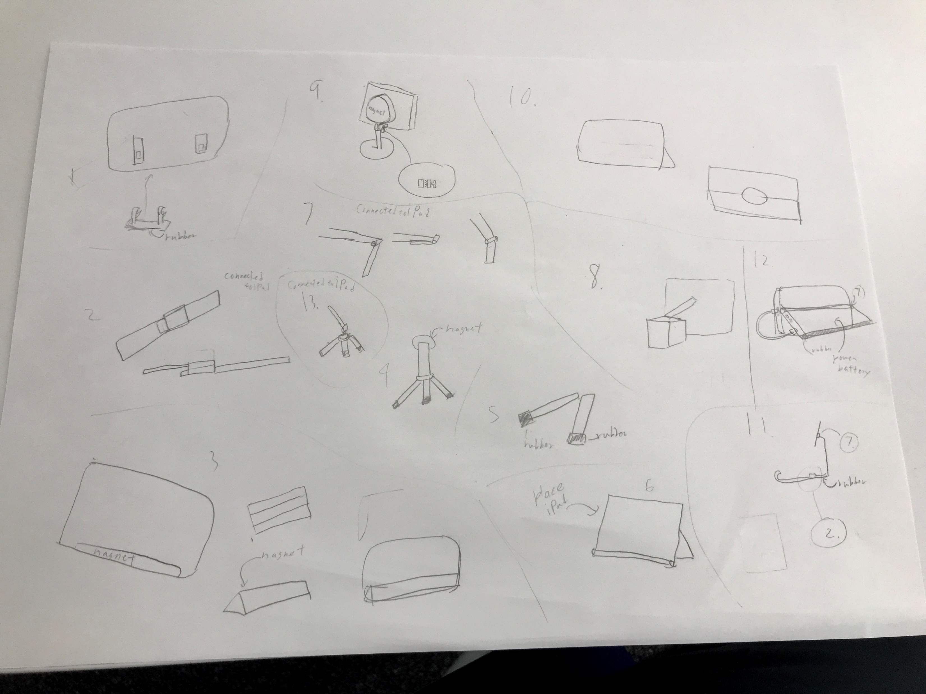
FIRST SKETCHES

Slide 9
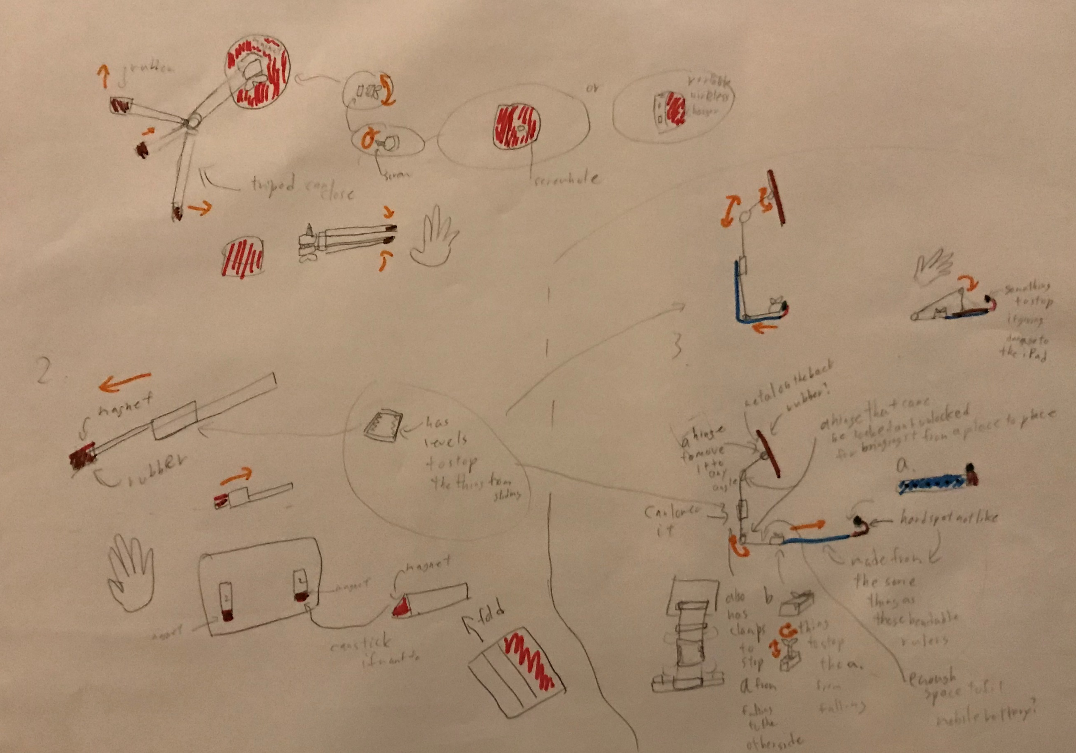
Second SKETCHES

Slide 10
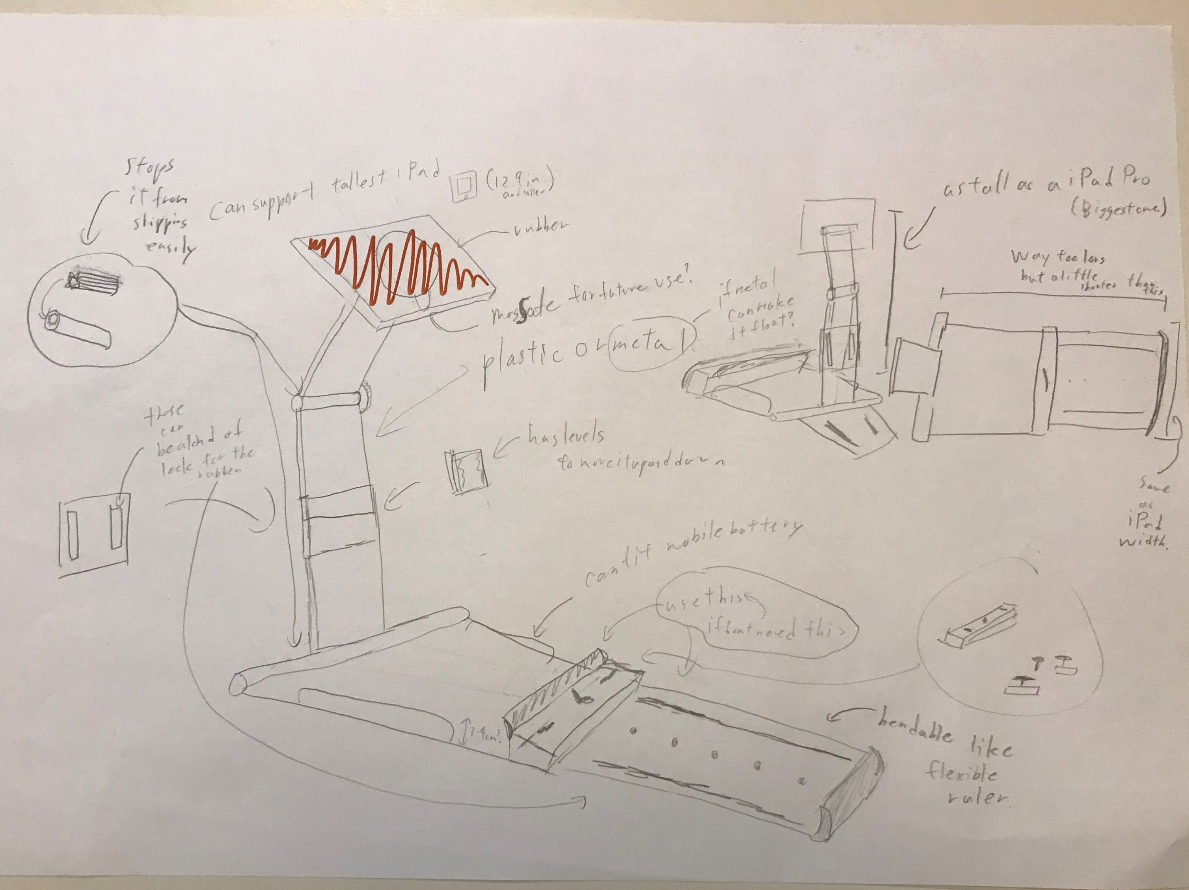
FINAL SKETCH

Slide 11
A card box protype of the original idea

Slide 12
I needed to make the cog

Slide 13
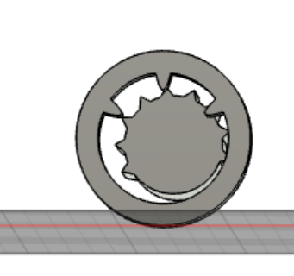
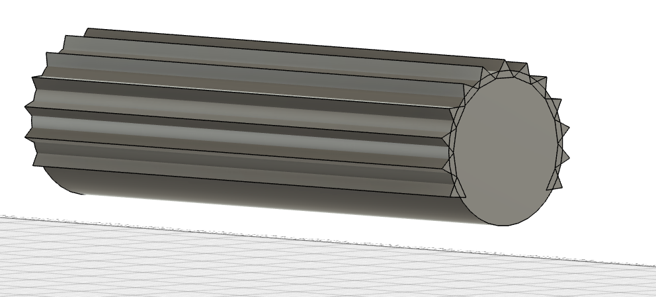
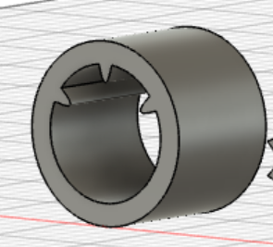
The cog I tried to make

Slide 14
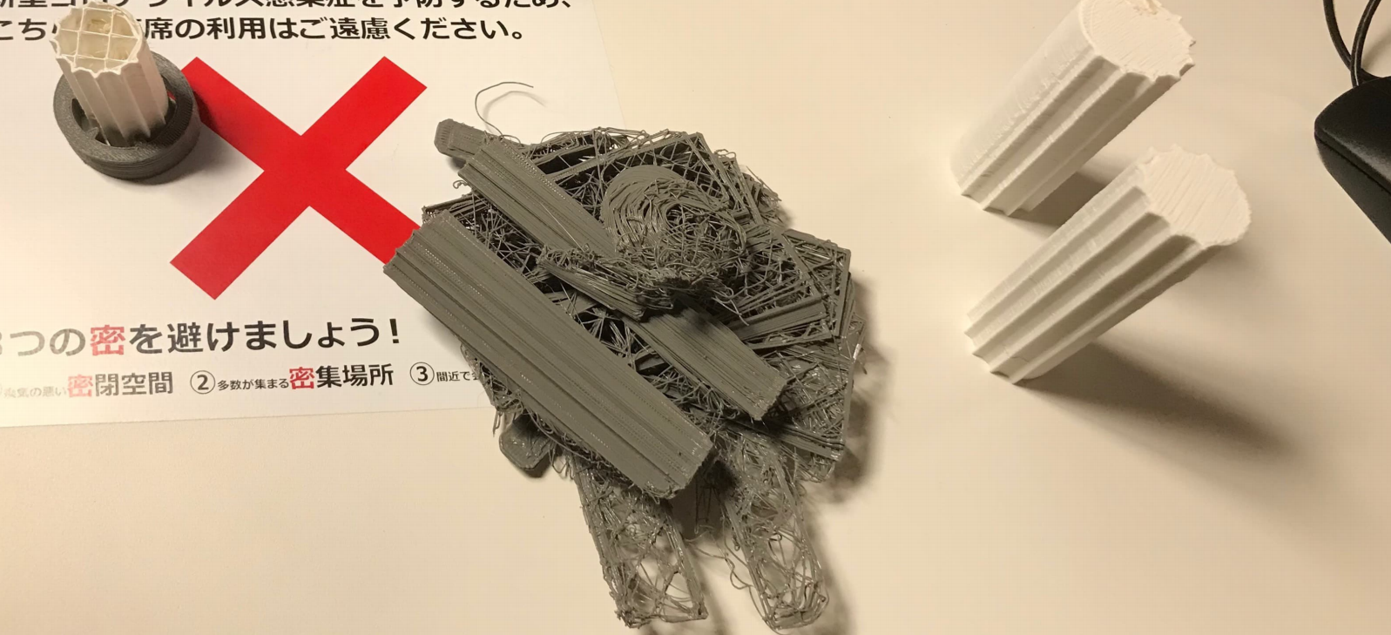

Slide 15
It didn’t work

Slide 16
The stop hinge I got as an replacement.

Slide 17
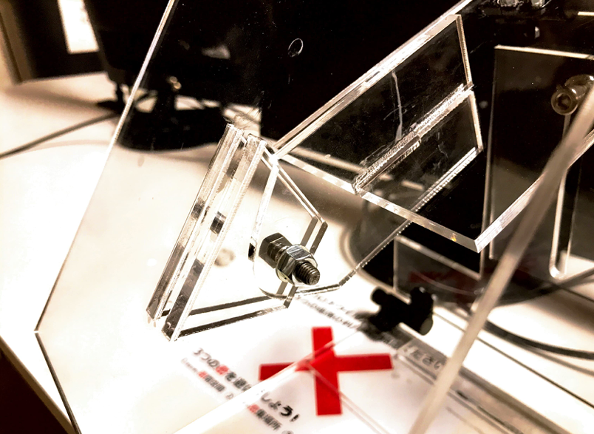
Friction Joint

Slide 18
Illustrator to cut out the Acrylic

Slide 20
This piece was way too fat for it to fold flat

Slide 21
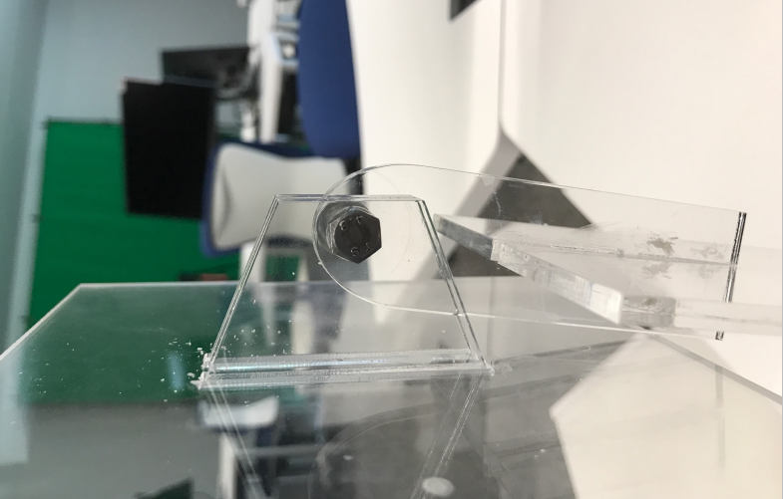
Fixed Piece

Slide 22
Finished product

Slide 23
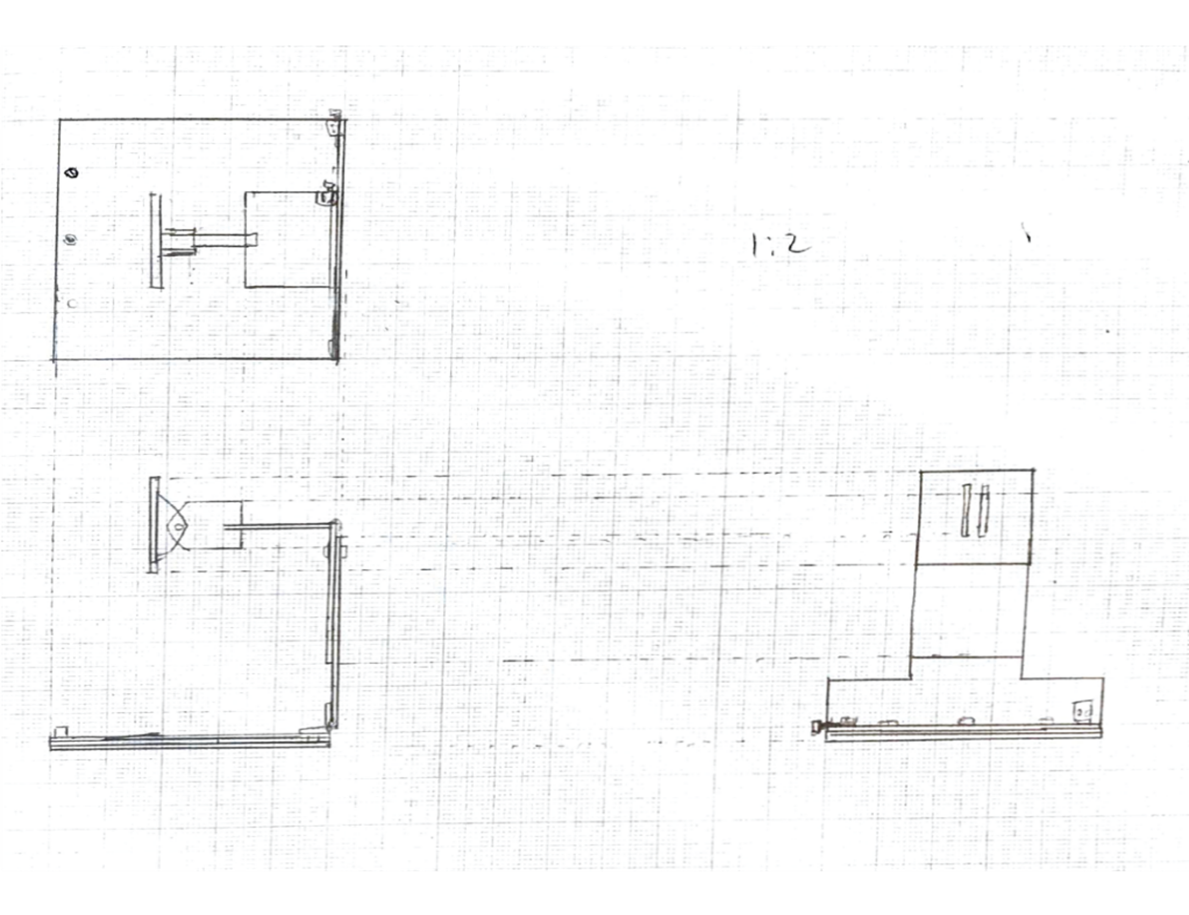
Final Sketch

Slide 24
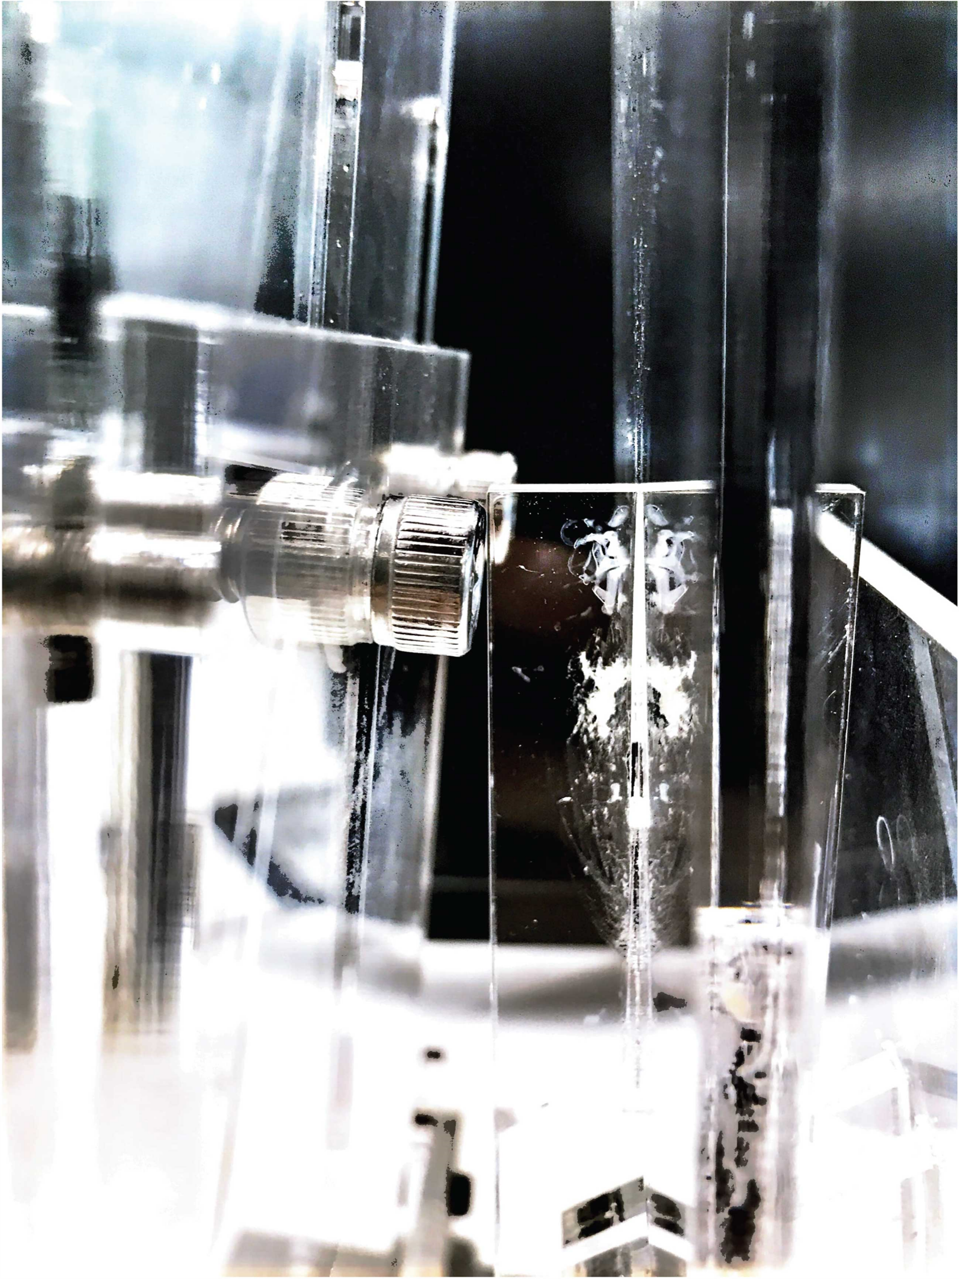
Conclusion
・Another joint for it to be more stable
・The screw and acrylic board bumps onto each other at one spot.
・So I have to move the screw away from the

Slide 25
Suggestions
I might need to make it a bit smaller.

